Slide 1
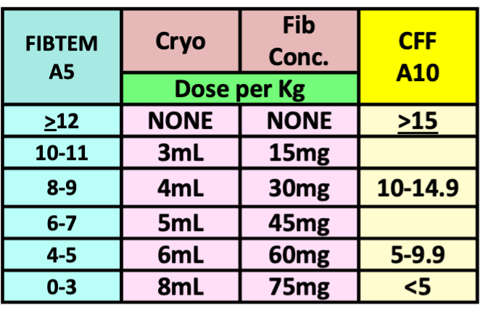
PAEDIATRIC ROTEM & TEG GOAL DIRECTED BLEEDING MANAGEMENT ALGORITHM (2025)
Temp >36° C, pH >7.2, iCalcium >1.1 mmol/L, Platelets >70x10⁹/L, Hb >75 g/L
Repeat test 10 mins
AFTER EACH INTERVENTION
IF BLEEDING CONTINUES
IS THERE CLINICALLY SIGNIFICANT BLEEDING?
YES
NO
ROTEM
Results in 10 min
Then
High risk of Fibrinolysis?
E.g. Trauma, craniofacial, major ortho Consider Tranexamic Acid 15mg/Kg
Observe
CLOT INSTABILITY Early diagnosis
EXTEM A5 <35mm | CRT A10 <47mm
Flat line FIBTEM or CRT at 5min
Tranexamic Acid
15mg/kg
Adjust subsequent dose for renal dysfunction
FIBRINOLYSIS
YES
Hyperfibrinolysis
PROCEED WITH ALGORITHM
NO
Cryo or FibConc.
If FIBTEM A5< 6 or CFF A10 <10,
ensure platelets are also available
RETEST
FIBRINOGEN
IS FIBTEM A5 < 12mm? (close correlation to Clauss fibrinogen) | Is CFF A10 < 15mm? (Local validation recommended)
Including flat line at 5 minutes Craniofacial cases, aim for higher target.
YES
Low Fibrinogen
Clinician discretion for Fibrinogen Concentrate
Usually single dose
Only for severely low FIBTEM <6mm or CFF <10mm
NO
NORMAL FIBTEM A5 ≥ 12mm AND IS EXTEM A5 < 35mm? | NORMAL CFF A10 > 15mm AND IS CRT A10 < 47mm?
YES
Poor Platelet Contribution
Pool Platelets
20mLs/kg
Chronic renal dysfunction, consider
Desmopressin / DDAVP
0.3microg/kg IV
Slow infusion over 30min
RETEST
PLATELETS
NO
NORMAL FIBTEM A5 ≥ 12mm AND IS EXTEM CT > 85 sec? | NORMAL CFF A10 > 15mm? AND Is CKH-R > 10 minutes
Ensure core temp >36°C and Fibrinogen corrected first
YES
Low Coagulation Factors or Oral anticoagulants (Warfarin or DOACs)
ELP/ FFP 20mLs/kg
OR
Beriplex
12.5 Units/kg IV
If volume overloaded
RETEST
FACTORS
NO
CLOT INSTABILITY after 30 minutes
IS FIBTEM ML ≥ 10 %? | Is CRT (LY30) > 2.2%
Clot should be stable for 1 hour, not tapering away
YES
Hyperfibrinolysis
Consider additional tranexamic acid
Consider APTEM if available to further investigate clot instability
E.g. Factor XIII, clot retraction
FIBRINOLYSIS
NORMAL
STILL BLEEDING? Consider SURGICAL PROBLEM and discuss with surgeon and blood bank/haematologist
Make a stronger clot? Give Cryo to FIBTEM A5 > 14mm Give platelets to EXTEM A5 > 40 mm or consider Platelet Function testing (in hours) Consider ELP to shorten clotting time to EXTEM CT < 80 sec | Re check temperature, pH, iCalcium, platelets and haemoglobin Consider other contributors to bleeding Platelet inhibitors (do Multiplate Platelet Function test) Consider Von Willebrand's Disease, warfarin (INR), enoxaparin etc.
When clinically possible always complete the algorithm in a stepwise manner and check the ROTEM between steps as indicated. This reduces unnecessary transfusion, especially of Platelets, ELP and Beriplex

